Slide 1


Quick Tips
All About
Lead Generation
Techniques
Lead Generation Techniques

Slide 2

What Do You Mean By Lead Generation
Lead generation is the process of generating consumer interest for a product or service with the goal of turning that interest into a sale. In online marketing this typically involves collecting a visitor's contact information (called a “lead”) via a web form.
Keywords
Lead Generation in Digital Marketing
Lead generation in digital marketing refers to the process of attracting and converting potential customers (leads) into interested prospects for a product or service. It's a crucial part of the marketing funnel where the primary goal is to gather information about potential customers, such as their contact details or demographics, so that they can be nurtured and eventually converted into paying customers.
In digital marketing, a lead refers to a potential customer who has expressed interest in a company's product or service by taking some form of action. This action could include visiting a website, signing up for a newsletter, downloading a whitepaper or ebook, filling out a contact form, or engaging with content such as liking a social media post or watching a video.
Standards

Slide 3

MICRO LEAD
These leads may have shown initial interest in a product or service but are not yet fully committed to making a purchase. Micro leads require follow-up to move them closer to conversion. In simple word in micro lead customer may have engaged with content, signed up for newsletters, or provided basic contact information, but they may not be as qualified or ready to buy as macro leads.

Slide 4
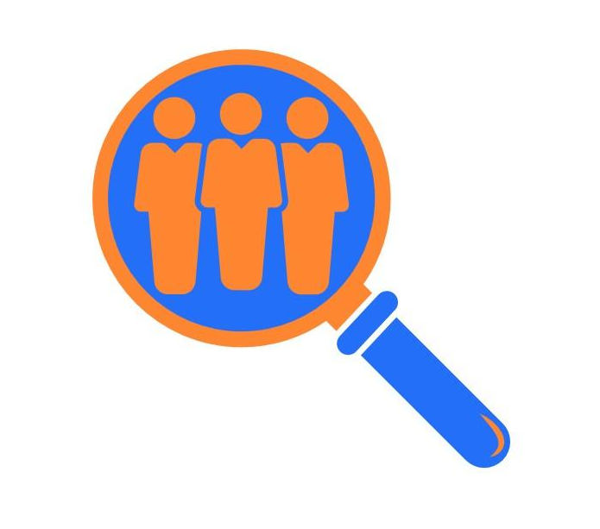
MACRO LEAD
Macro leads are more likely to result in significant conversions or sales for a business. These are high-quality leads that are further along in the sales funnel and are closer to making a purchasing decision. Macro leads typically have a higher level of interest, engagement, and intent to buy.

Slide 5
Tools Used For Lead Generation
1. Content Marketing:
2. Search Engine Optimization (SEO) : SEMrush, Moz, Ahrefs, Google Analytics
3. Social Media Marketing : Hello Bar, Sumo, OptinMonster, ConvertFlow
4. Email Marketing : Mailchimp, Constant Contact, GetResponse, AWeber
5. Pay-Per-Click (PPC) Advertising : Google Ads, Facebook Ads Manager, LinkedIn Ads, Twitter Ads.
6. Webinars and Events: Zoom, WebinarJam, GoToWebinar, Demio
Chatbots and Live Chat : Intercom, Drift, LiveChat, Tidio
A/B Testing
Landing Pages Optimization : for example show Pop-up form like Hello Bar, Sumo, OptinMonster, ConvertFlow, addthis.
Content Upgrades and Lead Magnets : Offering additional valuable resources or incentives (such as ebooks, guides, templates, or exclusive content) in exchange for a visitor's contact information.
Referral Programs: Encouraging satisfied customers or brand advocates to refer others to your business in exchange for rewards or incentives. Tools like ReferralCandy, Ambassador, InviteReferrals

Slide 6
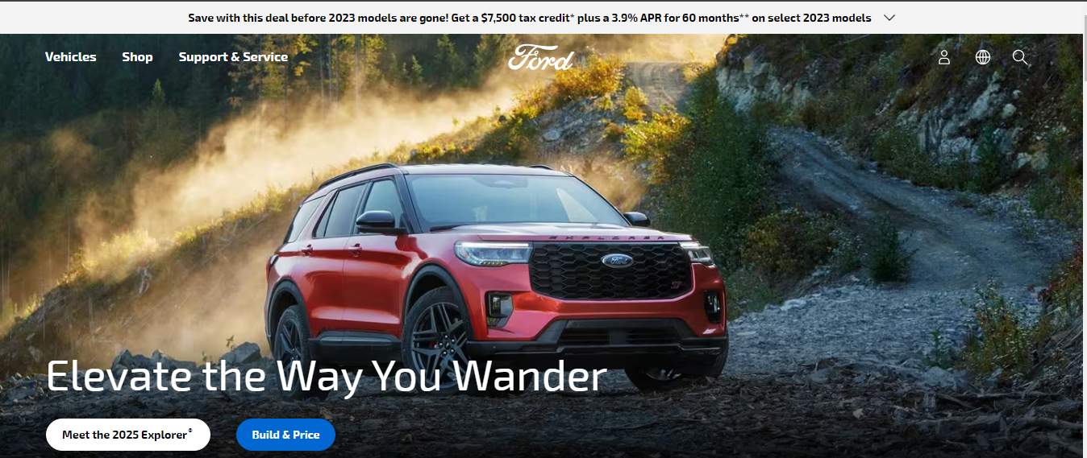
Types Of Landing Page 1) Click Through Landing Page : pages that have the goal of influence the visitors to click through to another page. E.g. banners that describe the offer in details with an intention to bring the visitors closer to purchasing decision

Slide 7
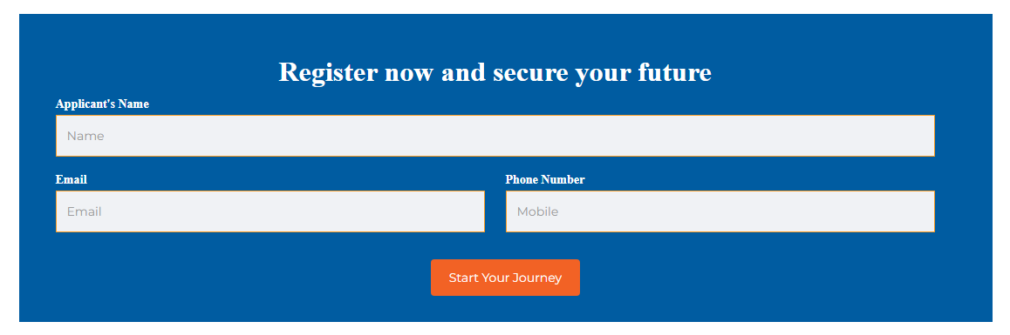
Types Of Landing Page 2) Lead Generation Landing Page : pages that are used to capture the visitors data, such as name, email in exchange for the offer that’s there

Slide 8
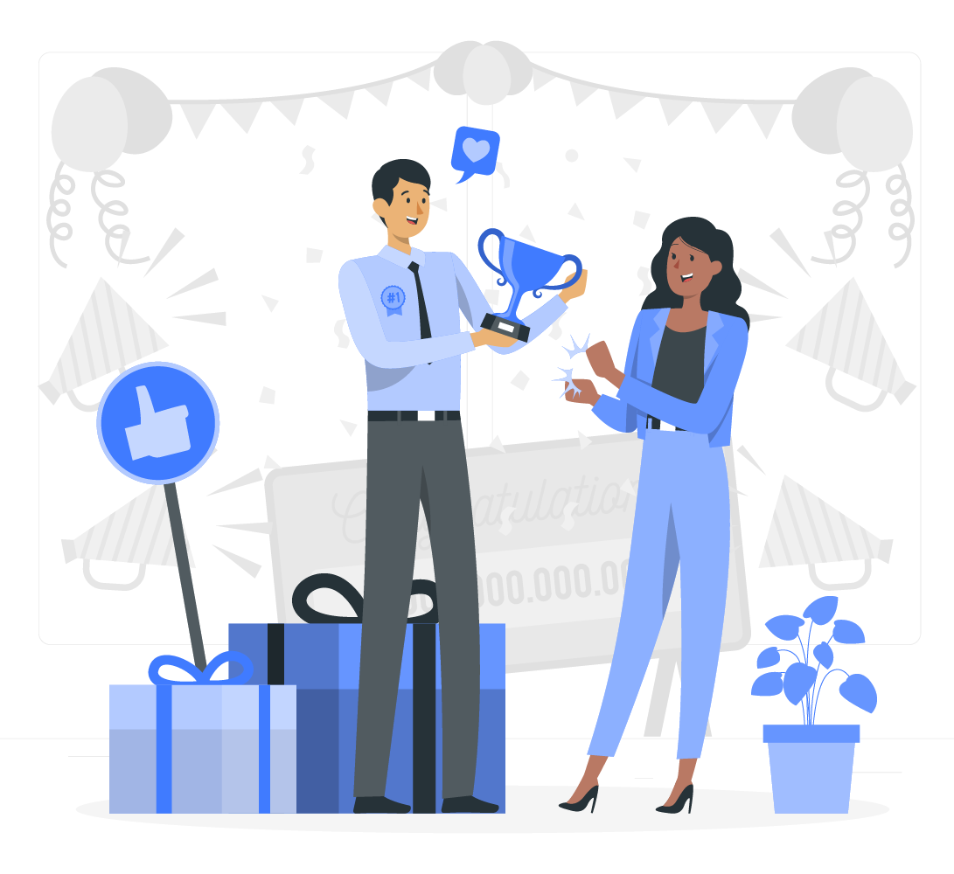
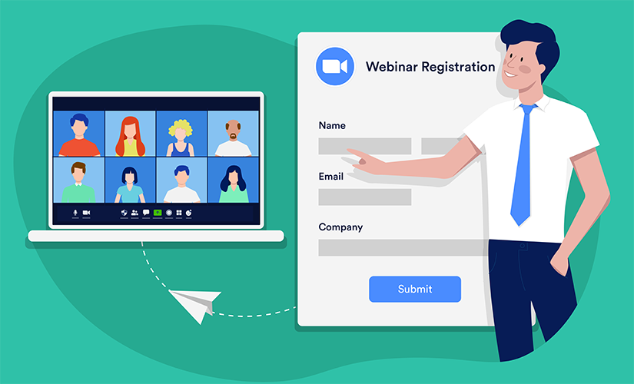
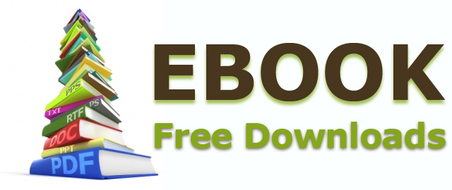
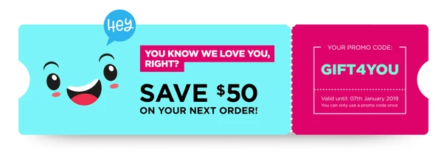
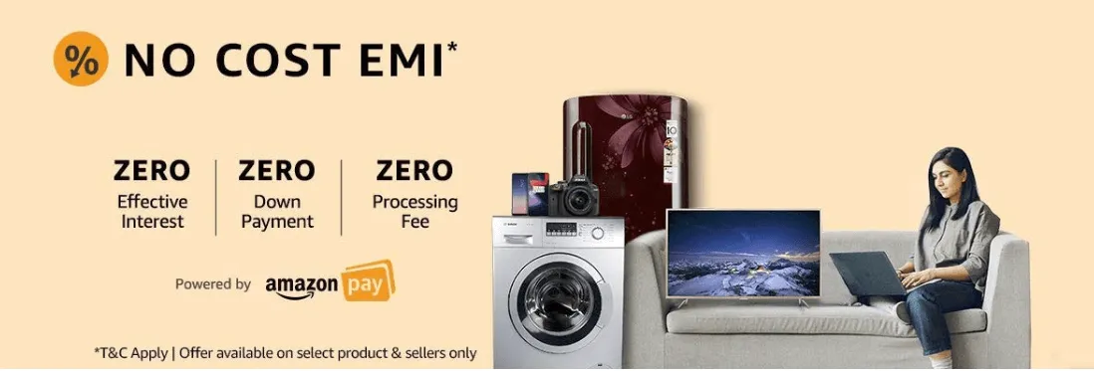
Offers that you can give 1) EBook or whitepaper 2) Webinar Registration 3) Discount Coupon / Voucher 4) Contest Entry 5) Free Trial

Slide 9
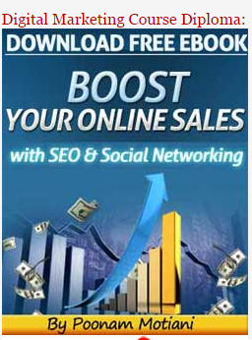
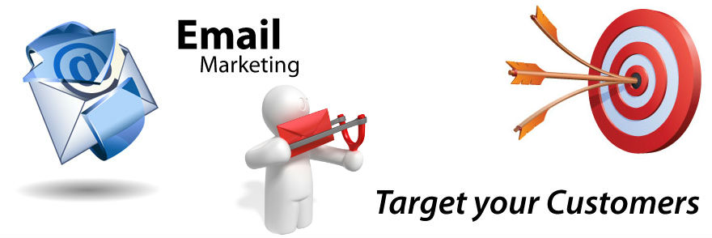
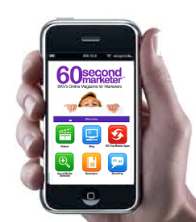
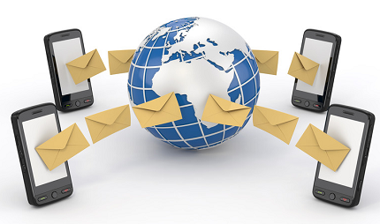
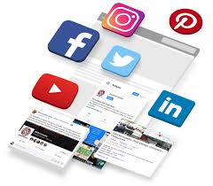


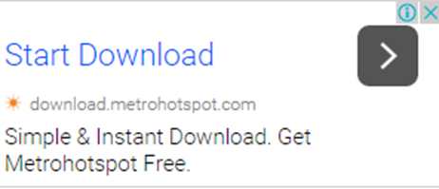
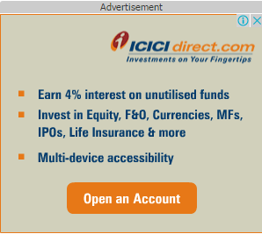
Emailing
SMS Marketing
Social Media Ads
Download Offer
Mobile Marketing
Social Media Cover Page
Display Network Banner Ads

Slide 10

Thanks

